Slide 1
Docker overview
Team five – internal tutorial
November, 10th 2022
Valentina Gaggero

Slide 2
Topics
What is Docker
Use cases
Container and images
Deployment on single host
Deployment on cluster
Deployment on iCub robots

Slide 3
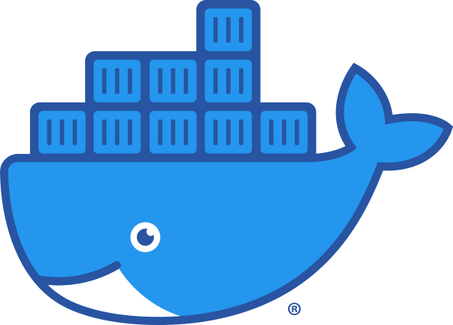
01 - Introduction To Docker
What is Docker?
Wikipedia defines Docker as:
an open-source project that automates the deployment of software applications inside containers by providing an additional layer of abstraction and automation of OS-level virtualization on Linux.
Docker is a tool that allows developers to easily deploy their applications in a sandbox (called containers) to run on the host operating system

Slide 4

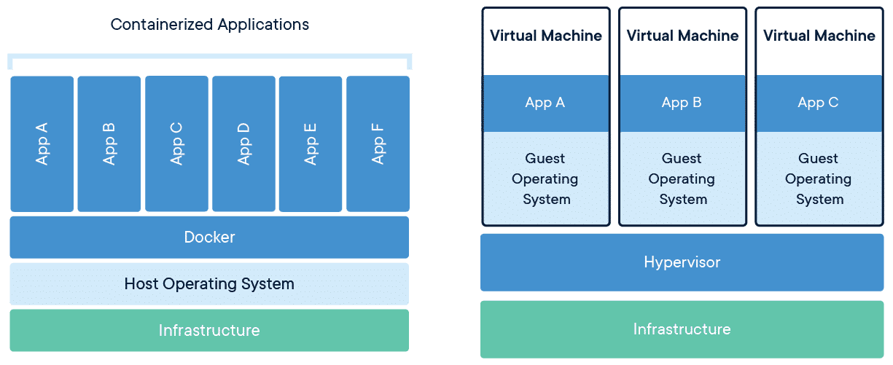
01 - Introduction To Docker
Docker vs Virtual machines
Docker is NOT a virtual machine
Docker
Virtual machine
Relies on the system's physical hardware
Needs a Hypervisor and a full OS inside
Heavier
Deployment/portability tough
Lightweight
Easy Deployment / portability with minimal requirements
Faster
Docker container
Virtual machine

Slide 5
02 – Use Cases
Use case 1: two applications need two different version of same library
CONTAINERS
?
Math library ver 2
Math library ver 3
Application A
Application B
My computer

Slide 6

02 – Use Cases
Use case 2: run application composed by many modules (executables)
Deployment
Avoid to run each single module by hand every time.
Write a file with the list of modules only once
iKinCartesianSolver
iKinCartesianSolver
iKinGazeCtrl
pf3Tracker
…
yarprobotinterface
imuFIlter
demoRedBall
wholeBodyDynamics
yarpview
gravityCompensator
camCalib left
yarpdev cameras
camCalib right
yarpdev face
emotionInterface

Slide 7
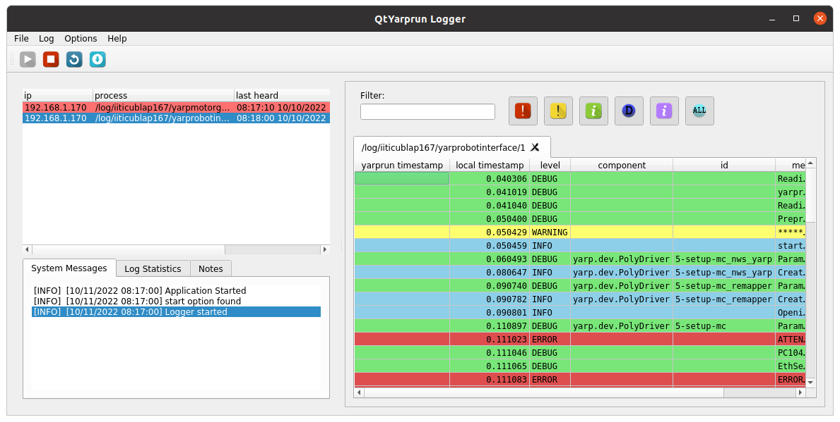

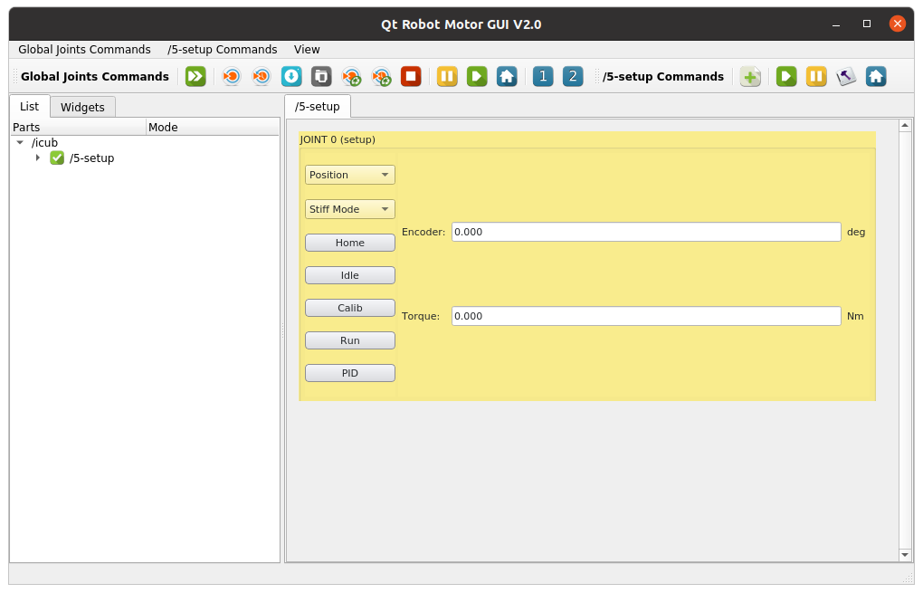
02 – Use Cases
A real use case: motor brake setup
Yarp server
Yarp logger
Yarp motorgui
yarprobotinterface
2FOC
Magtrol
EMS
MotorBrakeManager

Slide 8

03 – Containers and Images
Docker Essentials
Docker Image: is a read-only, inert template that comes with instructions for deploying containers.
Images are stored on a Docker registry, such as
Docker Hub, or on a local registry.
Docker Container: is an instance of a Docker image. It is a virtualized runtime environment that provides isolation capabilities for separating the execution of applications from the underpinning system.
Images are read-only templates used to build containers.
Containers are deployed instances created from those templates.
Container_one
Dependencies,
Source code,
Libraries, etc
Container_two
Docker image
Container_...

Slide 9
03 – Containers and Images
Hands on
Create an image
Create a simple container
Share file with the host
Share environment variable with the host
Use option network host

Slide 10
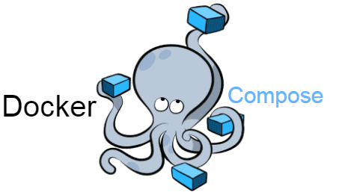
03 – Deployment On Single Host
What is Docker Compose?
Docker Compose is a tool for defining and running multi-container Docker applications.
Why Docker Compose?
Configuring the application services through a unique configuration file
Create and start multiple services with a single command
Notes:
<number>

Slide 11
03 – Deployment On Single Host
See the motor brake setup’s deployment file
Attention: a service is not a container

